Slide 1
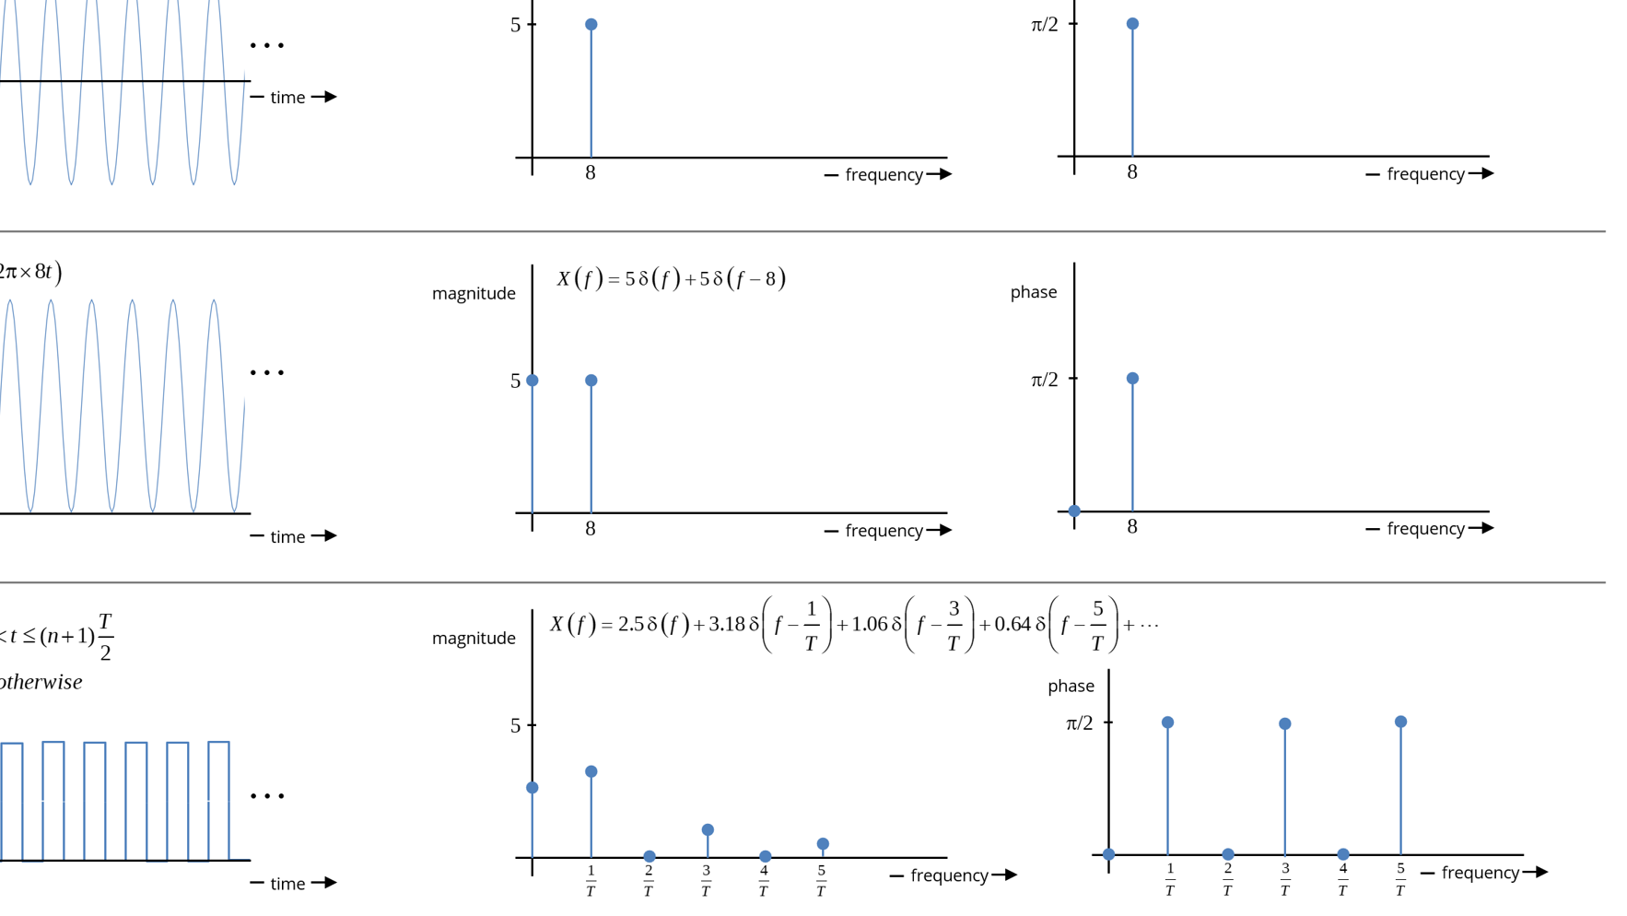
EG431D Data Acquisition
Frequency Domain Analysis

Slide 2
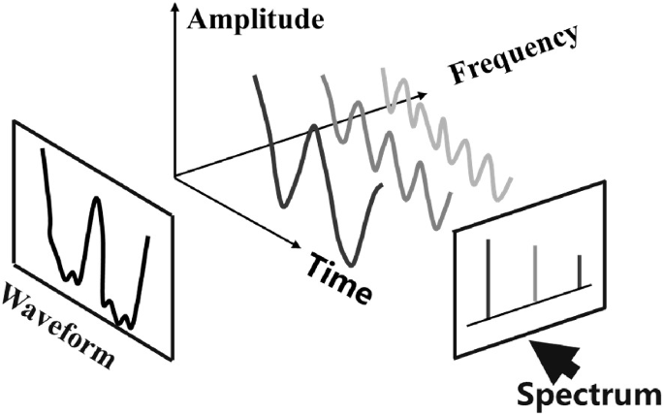
Objectives
Learning Objectives:
Describe the process of analyzing stationary and non-stationary signals in the frequency domain.
Explain the fundamental principles of Fourier Transform, FFT, and STFT.
Demonstrate practical applications of frequency domain analysis in real-world scenarios.
Key Applications:
Audio processing
Biomedical signal analysis
Machine vibration analysis

Slide 3
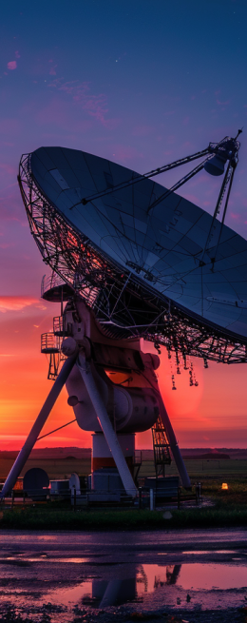
Introduction to Frequency Domain Analysis
What is Frequency Domain Analysis?
Focuses on understanding the frequency components of a signal.
Decomposes signals into sinusoidal components (frequencies, amplitudes, phases).
Comparison with Time-Domain:
Time-domain: Amplitude vs. Time.
Frequency-domain: Amplitude vs. Frequency.
Core Mathematical Tool: Fourier Transform.

Slide 4
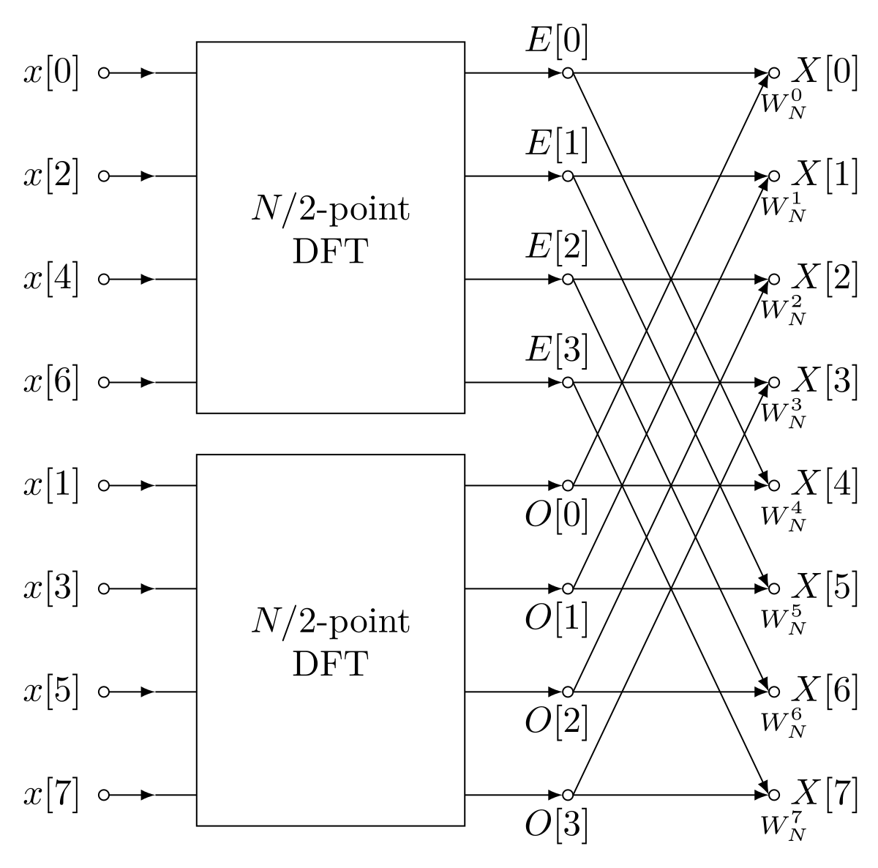
Fourier Transform and FFT
Fourier Transform (FT):
Converts time-domain signal x(t) to frequency-domain X(f).
Represents signals as a sum of sinusoids.
Discrete Fourier Transform (DFT):
Sampled version of FT for discrete signals.
Fast Fourier Transform (FFT):
Efficient algorithm for computing DFT.
Reduces complexity from O(N2) to O(NlogN).
Applications:
Spectral analysis, filtering, and system characterization.

Slide 5

FFT Algorithm
Radix-2 Cooley-Tukey FFT:
Assumes N (number of samples) is a power of 2.
Recursively breaks DFT into smaller DFTs.
Twiddle Factors:
Precomputed values of e^{−j2πkn/N}.
Output Interpretation:
Magnitude ∣X[k]∣: Amplitude of frequency components.
Phase ∠X[k]: Phase shift of components.

Slide 6
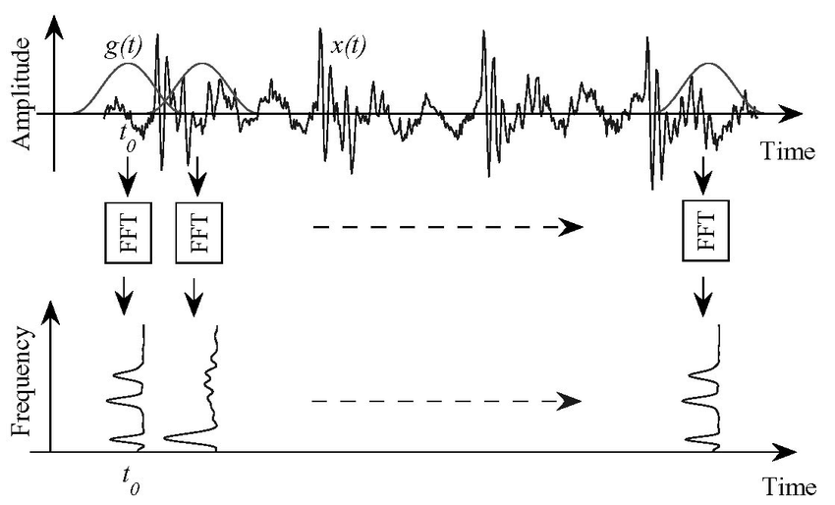
Short-Time Fourier Transform (STFT)
What is STFT?
Analyzes signals with time-varying frequency content.
Segments signals into smaller time windows.
Applications:
Audio processing (speech, music, noise reduction).
Biomedical signal analysis (EEG, ECG).
Mechanical vibration analysis (fault detection).
Seismic and geophysical applications.

Slide 7
Applications of STFT
Audio Signal Analysis:
Speech analysis and synthesis.
Music signal processing (harmonics, rhythm).
Noise reduction.
Biomedical Signal Analysis:
EEG signal processing (epileptic seizures).
Heart Rate Variability (HRV) analysis.
Mechanical Vibration Analysis:
Condition monitoring.
Rotational machinery diagnostics.

Slide 8
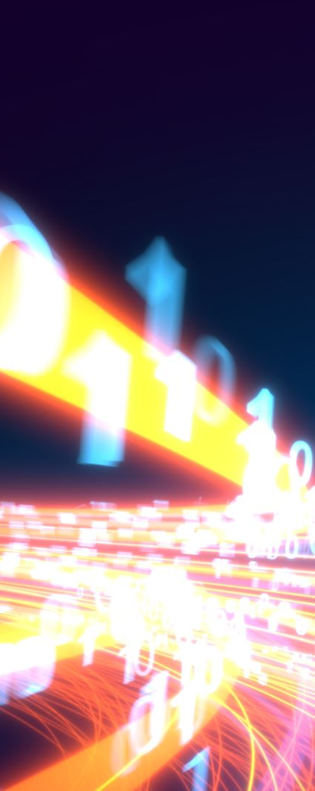
Frequency Domain Analysis with Arduino
ArduinoFFT Library:
Optimized FFT implementation for Arduino.
Signal Acquisition:
Analog-to-Digital Conversion (ADC) sampling.
Nyquist criterion: Sampling rate ≥ 2 × highest frequency.
Applications:
Vibration analysis (machine condition monitoring).
Bio-signal processing (heart rate, EEG).
Spectrum monitoring (radio, sound frequencies).

Slide 9
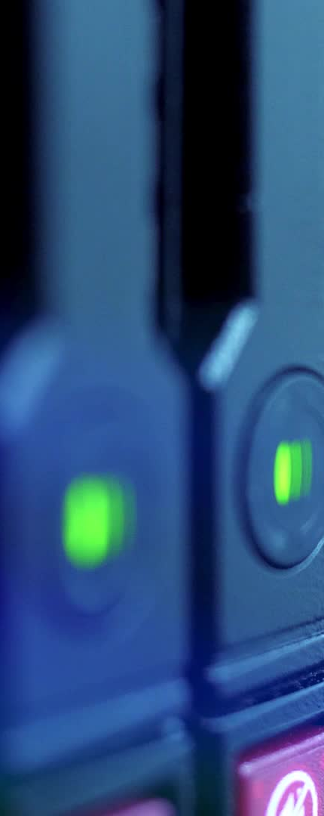
Audio Signal Analysis with Arduino
Environmental Sound Analysis:
Microphone module captures audio signals.
Sampling rate: 8 kHz (for frequencies up to 4 kHz).
FFT transforms time-domain data to frequency domain.
Applications:
Noise monitoring (industrial, urban environments).
Sound classification (wildlife, machinery).

Slide 10
Vibration Analysis with Arduino
Machine Condition Monitoring:
Tri-axial accelerometer measures vibrations.
FFT converts time-domain vibrations to frequency domain.
Fault Detection:
Imbalance, misalignment, bearing wear.
Predictive Maintenance:
Continuous monitoring and trend analysis.
Early detection of mechanical issues.

Slide 11
Heart Rate Variability (HRV) Analysis
What is HRV?
Variation in time between successive heartbeats (RR intervals).
Reflects autonomic nervous system function.
Frequency Domain Analysis:
Low-Frequency (LF) band: Sympathetic and parasympathetic activity.
High-Frequency (HF) band: Parasympathetic activity (relaxation).
LF/HF ratio: Indicator of stress and autonomic balance.
Arduino Implementation:
MAX30100 pulse oximeter sensor.
ArduinoFFT library for PSD (Power Spectral Density) analysis.

Slide 12
Practical Applications of HRV Analysis
Stress Monitoring:
Real-time tracking of LF and HF bands.
Stress-relief techniques (deep breathing, meditation).
Long-Term Health Metrics:
Daily LF/HF ratio trends.
Chronic stress detection and lifestyle adjustments.

Slide 13

Comparison with Frequency Domain Analysis
Time Domain Focus: Temporal changes, transient events.
Frequency Domain Focus: Spectral content of signals.
Complementary Techniques: Foundation for Fourier analysis and predictive modeling.

Slide 14
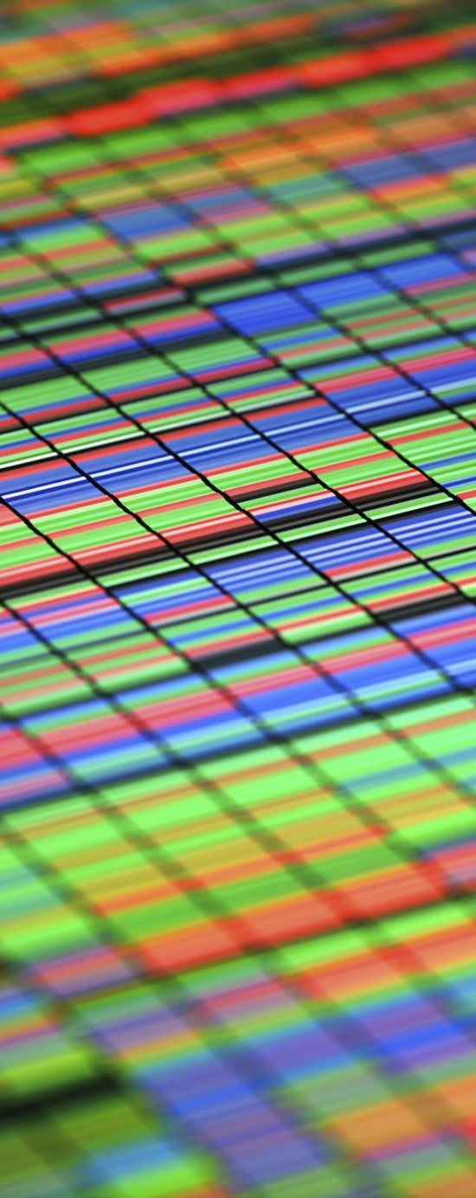
Summary
Key Takeaways:
Frequency domain analysis reveals signal characteristics not visible in the time domain.
FFT and STFT are powerful tools for analyzing stationary and non-stationary signals.
Arduino enables practical, real-time frequency domain analysis in various applications.
Applications:
Audio processing, biomedical signal analysis, machine vibration monitoring, and more.

